Slide 1

Self Driving AI Car Simulator

Slide 2
What are Self-Driving Cars?
A self-driving car (sometimes called an autonomous car or driverless car) is a vehicle that uses a combination of sensors, cameras, radar and artificial intelligence (AI) to travel between destinations without a human operator. To qualify as fully autonomous, a vehicle must be able to navigate without human intervention to a predetermined destination over roads that have not been adapted for its use.

Slide 3

How our self-driving car simulator work(Using NEAT)
NEAT (NeuroEvolution of Augmenting Topologies) is an evolutionary algorithm that creates artificial neural networks . NEAT is a method developed by Kenneth O. Stanley for evolving arbitrary neural networks. NEAT-Python is a pure Python implementation of NEAT, with no dependencies other than the Python standard library. In the current implementation of NEAT-Python, a population of individual genomes is maintained. Each genome contains two sets of genes that describe how to build an artificial neural network: 1. Node genes, each of which specifies a single neuron. 2. Connection genes, each of which specifies a single connection between neurons.

Slide 4


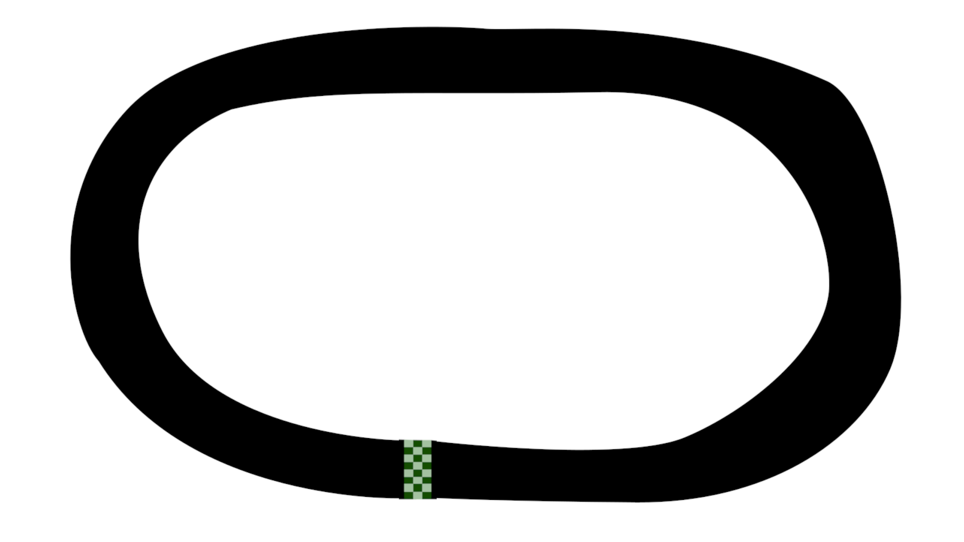


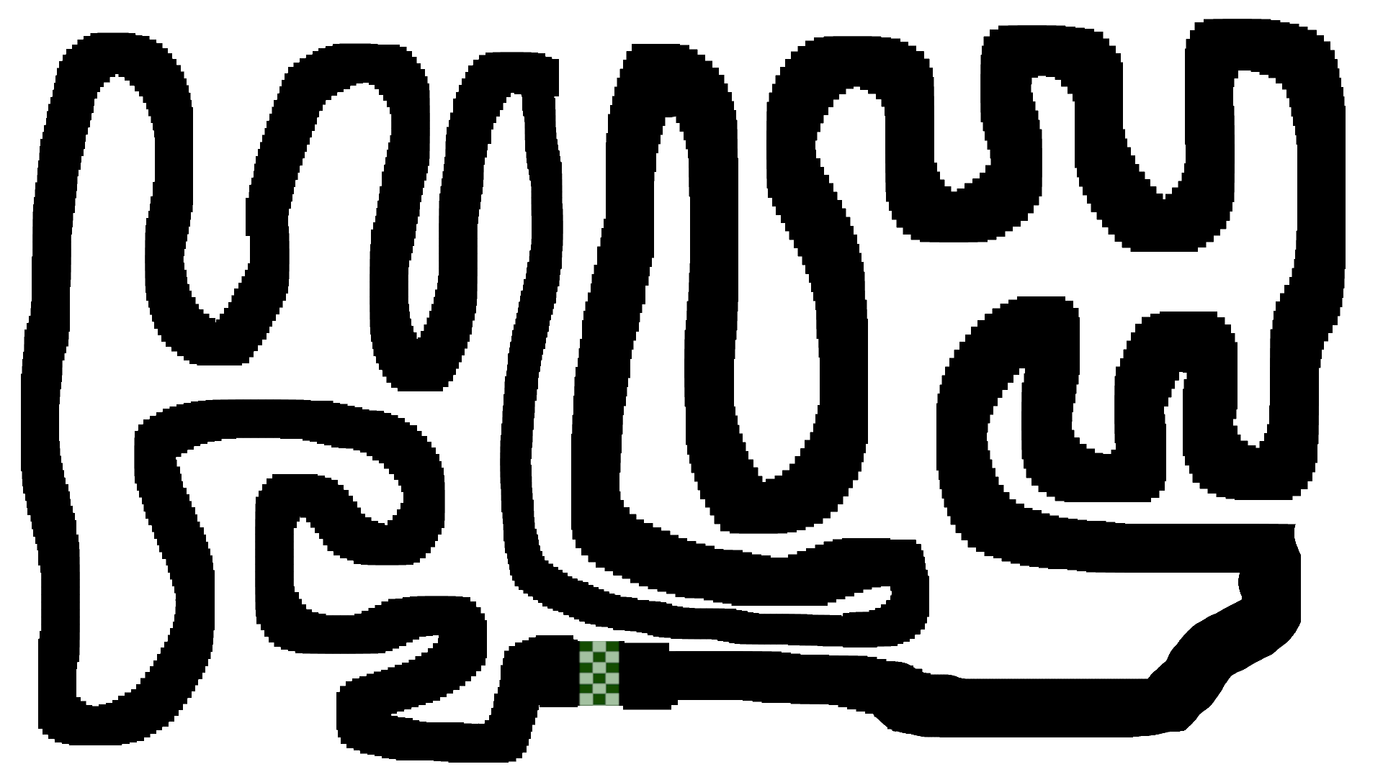
Screenshots

Slide 5
CONFIG
[NEAT]
fitness_criterion = max
fitness_threshold = 100000000
pop_size = 30
reset_on_extinction = True
[DefaultGenome]
# node activation options
activation_default = tanh
activation_mutate_rate = 0.01
activation_options = tanh

Slide 6
Uses
The simulator is capable of taking the vehicle into its limits of operations by navigating it through challenging scenarios/maps.
In general, a research grade driving simulator can help bridge the gap in development between simulation and laboratory analysis, on the one hand, and proving ground tests with actual prototype systems and vehicles on the other

Slide 7

Team
Shubh Sarpal
Ravinder Bishnoi
Aditya Pandey

